Slide 1


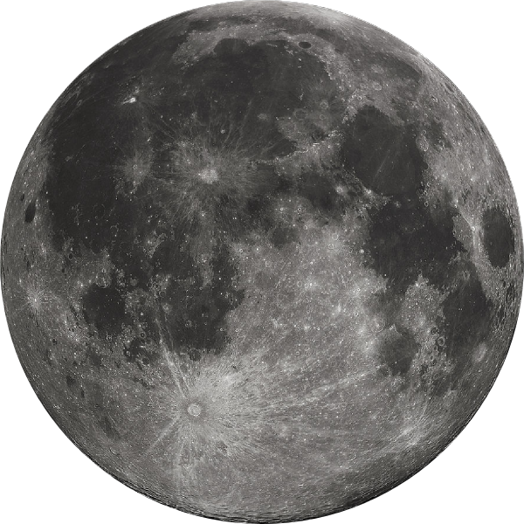
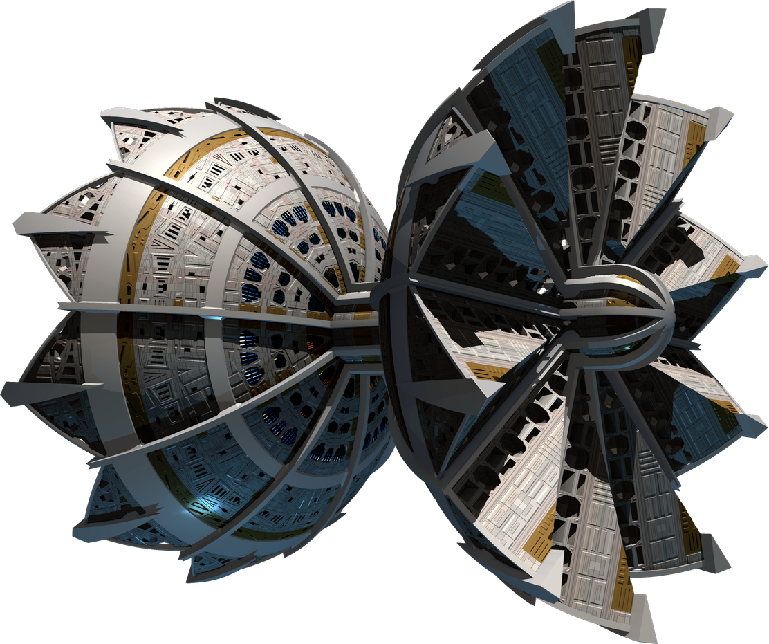
Project NovaOre
Project NovaOre
Earth’s next resource frontier
Beyond Earth. Beyond Limits. Beyond Scarcity.
404: Brain not found

Slide 2
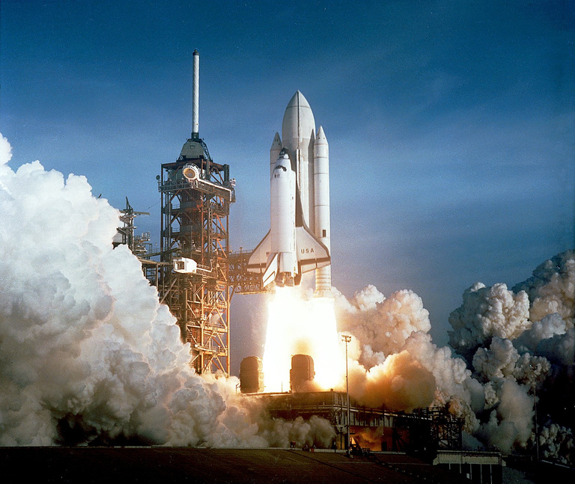
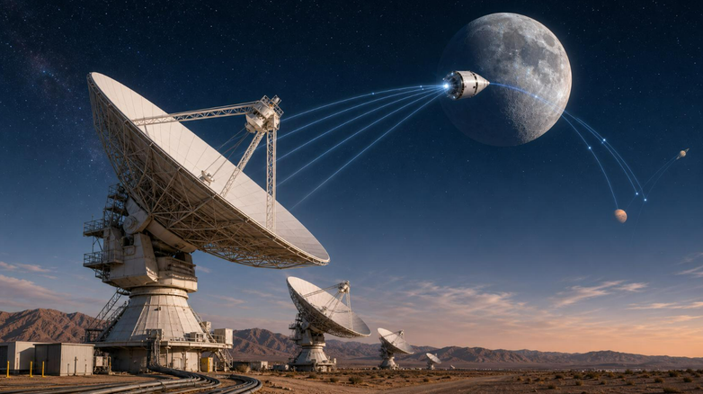
SubPart A - ENGINEERING
BUILD THE MINING ARCHITECTURE
Reaching & Landing & Operation
Communication
  Propulsion system
  Hybrid engines (Solar + Propellant)
  Gripping Mechanism
  Spectroscopic sensors: detect level of the ore on asteroids
  Radio Antennas and Relay satellites
  Mining Probes will indepently perform routine tasks
  Equipment Failure: monitoring of temperature, power motors and propulsion.
  Backup systems and auto-fault detection
  Refining - Done on the Carrier (Majorly)
  Some is done during extraction itself using magnets & other tech
  Semi-refined ores taken to lunar base for refining using solar mirrors to remove sludge from ores
  Using Delay/Disruption Tolerant Networking (DTN)
  The rover / spacecraft could carry:
  visible & infrared spectrometers
  X-ray fluorescence (XRF)
  Neutron & gamma-ray instruments
  Radars, cameras & thermal sensors
  Optical navigation
  LiDAR: Laser pulses → generate surface maps
  Inertial Measurement Units(IMUs): Gyroscopes & accelerometers

Slide 3
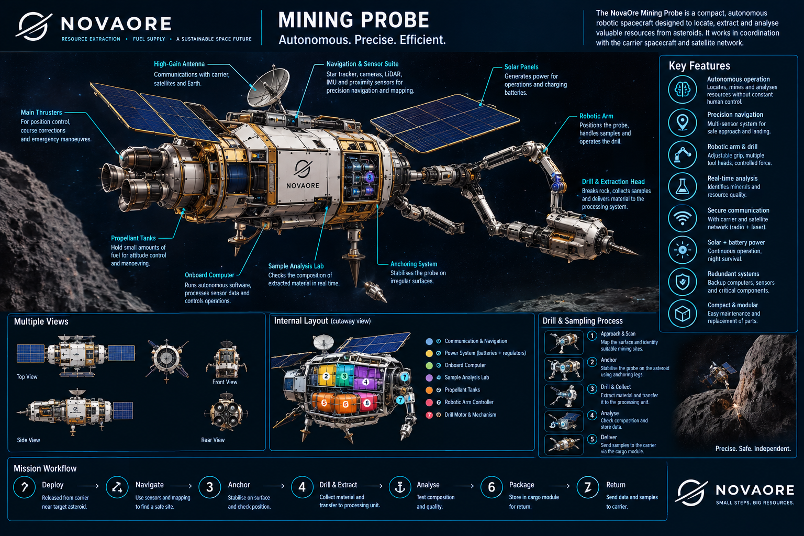

Slide 4
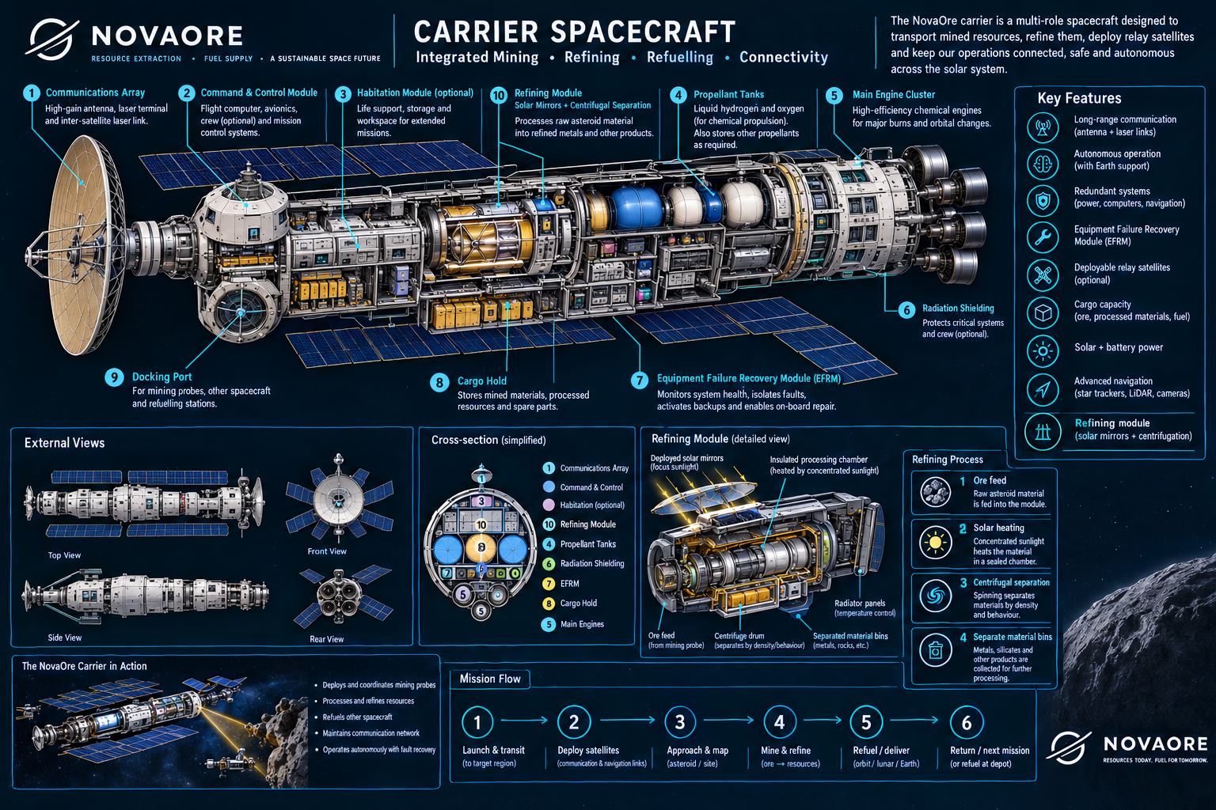

Slide 5
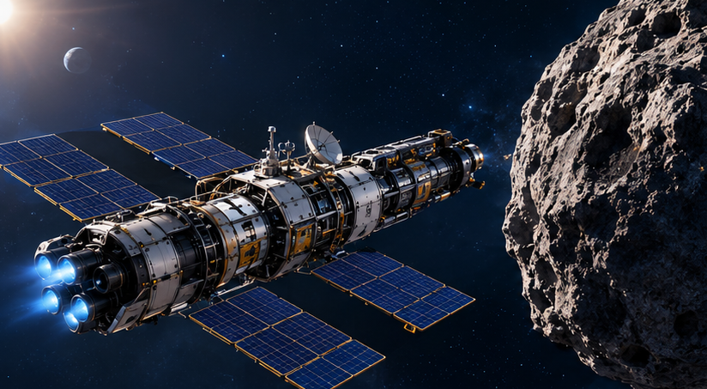
SubPart B
  Communication Cost
Instead of sending multiple sattelites in space to keep track of our carriers and probes, we will integrate them within our carriers which will result in more targeted communication.
Major Cost Drivers
  Fuel Cost → Expensive
HYBRID SYSTEM- (less fuel means less thrust tho)
We solve that by making use of the water ice we mine
  Making a Lunar Base will be Expensive
(kind of like a Space Pump-- lookout for this in our buisness proposal)
We reduce fuel cost for refining by using solar mirrors and a centrifugation process
Hence we proposed integration of our refining systems in our carriers initially, until we get some capital flowing
  Transportation Cost
Launching from Earth is EXPENSIVE
·Surface gravity: 9.81 m/s², Escape velocity: 11.2 km/s, air resistance
·Rockets need enormous amounts of fuel to lift themselves and their payload.
Launching from the Moon however-
·Surface gravity: 1.62 m/s² (about one-sixth of Earth's), Escape velocity: 2.38 km/s, Virtually no atmosphere, so almost no atmospheric drag.
·A rocket needs much less velocity change to escape the Moon's gravity.
DESIGN FOR MINIMUM COST

Slide 6
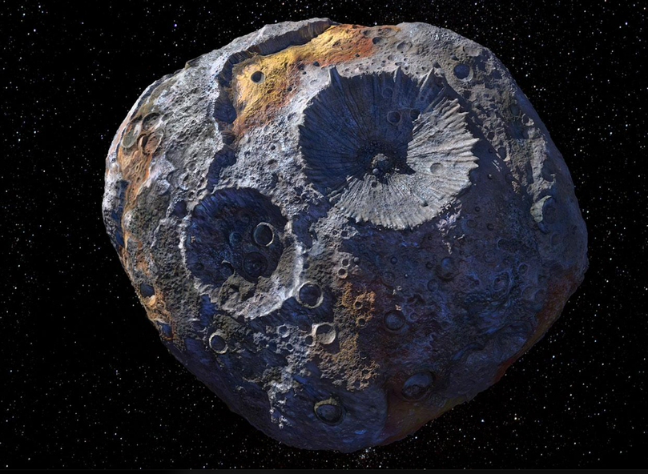
SubPart C
What are we mining?
BUSINESS: Who pays for it?
Majorly:
Ice Water
COSTUMER BASE
Available Platinum, nickel & iron
Space Companies-- companies can reduce the weight of their probes and rockets by relying on our “Space Pumps”.
Industrialists-- since we can mine a lot of Iron and Platinum cheaply in space, iron and platinum needed in space can be supplied by us as well as on earth as environmental concerns come into play.
USE:
Ice water → steam → sold as fuel to space companies
Become a leading supplier of iron and platinum
Making Money ~~
Space Pumps
Orbital Manufacturing
Platinum Monopoly 😈

Slide 7
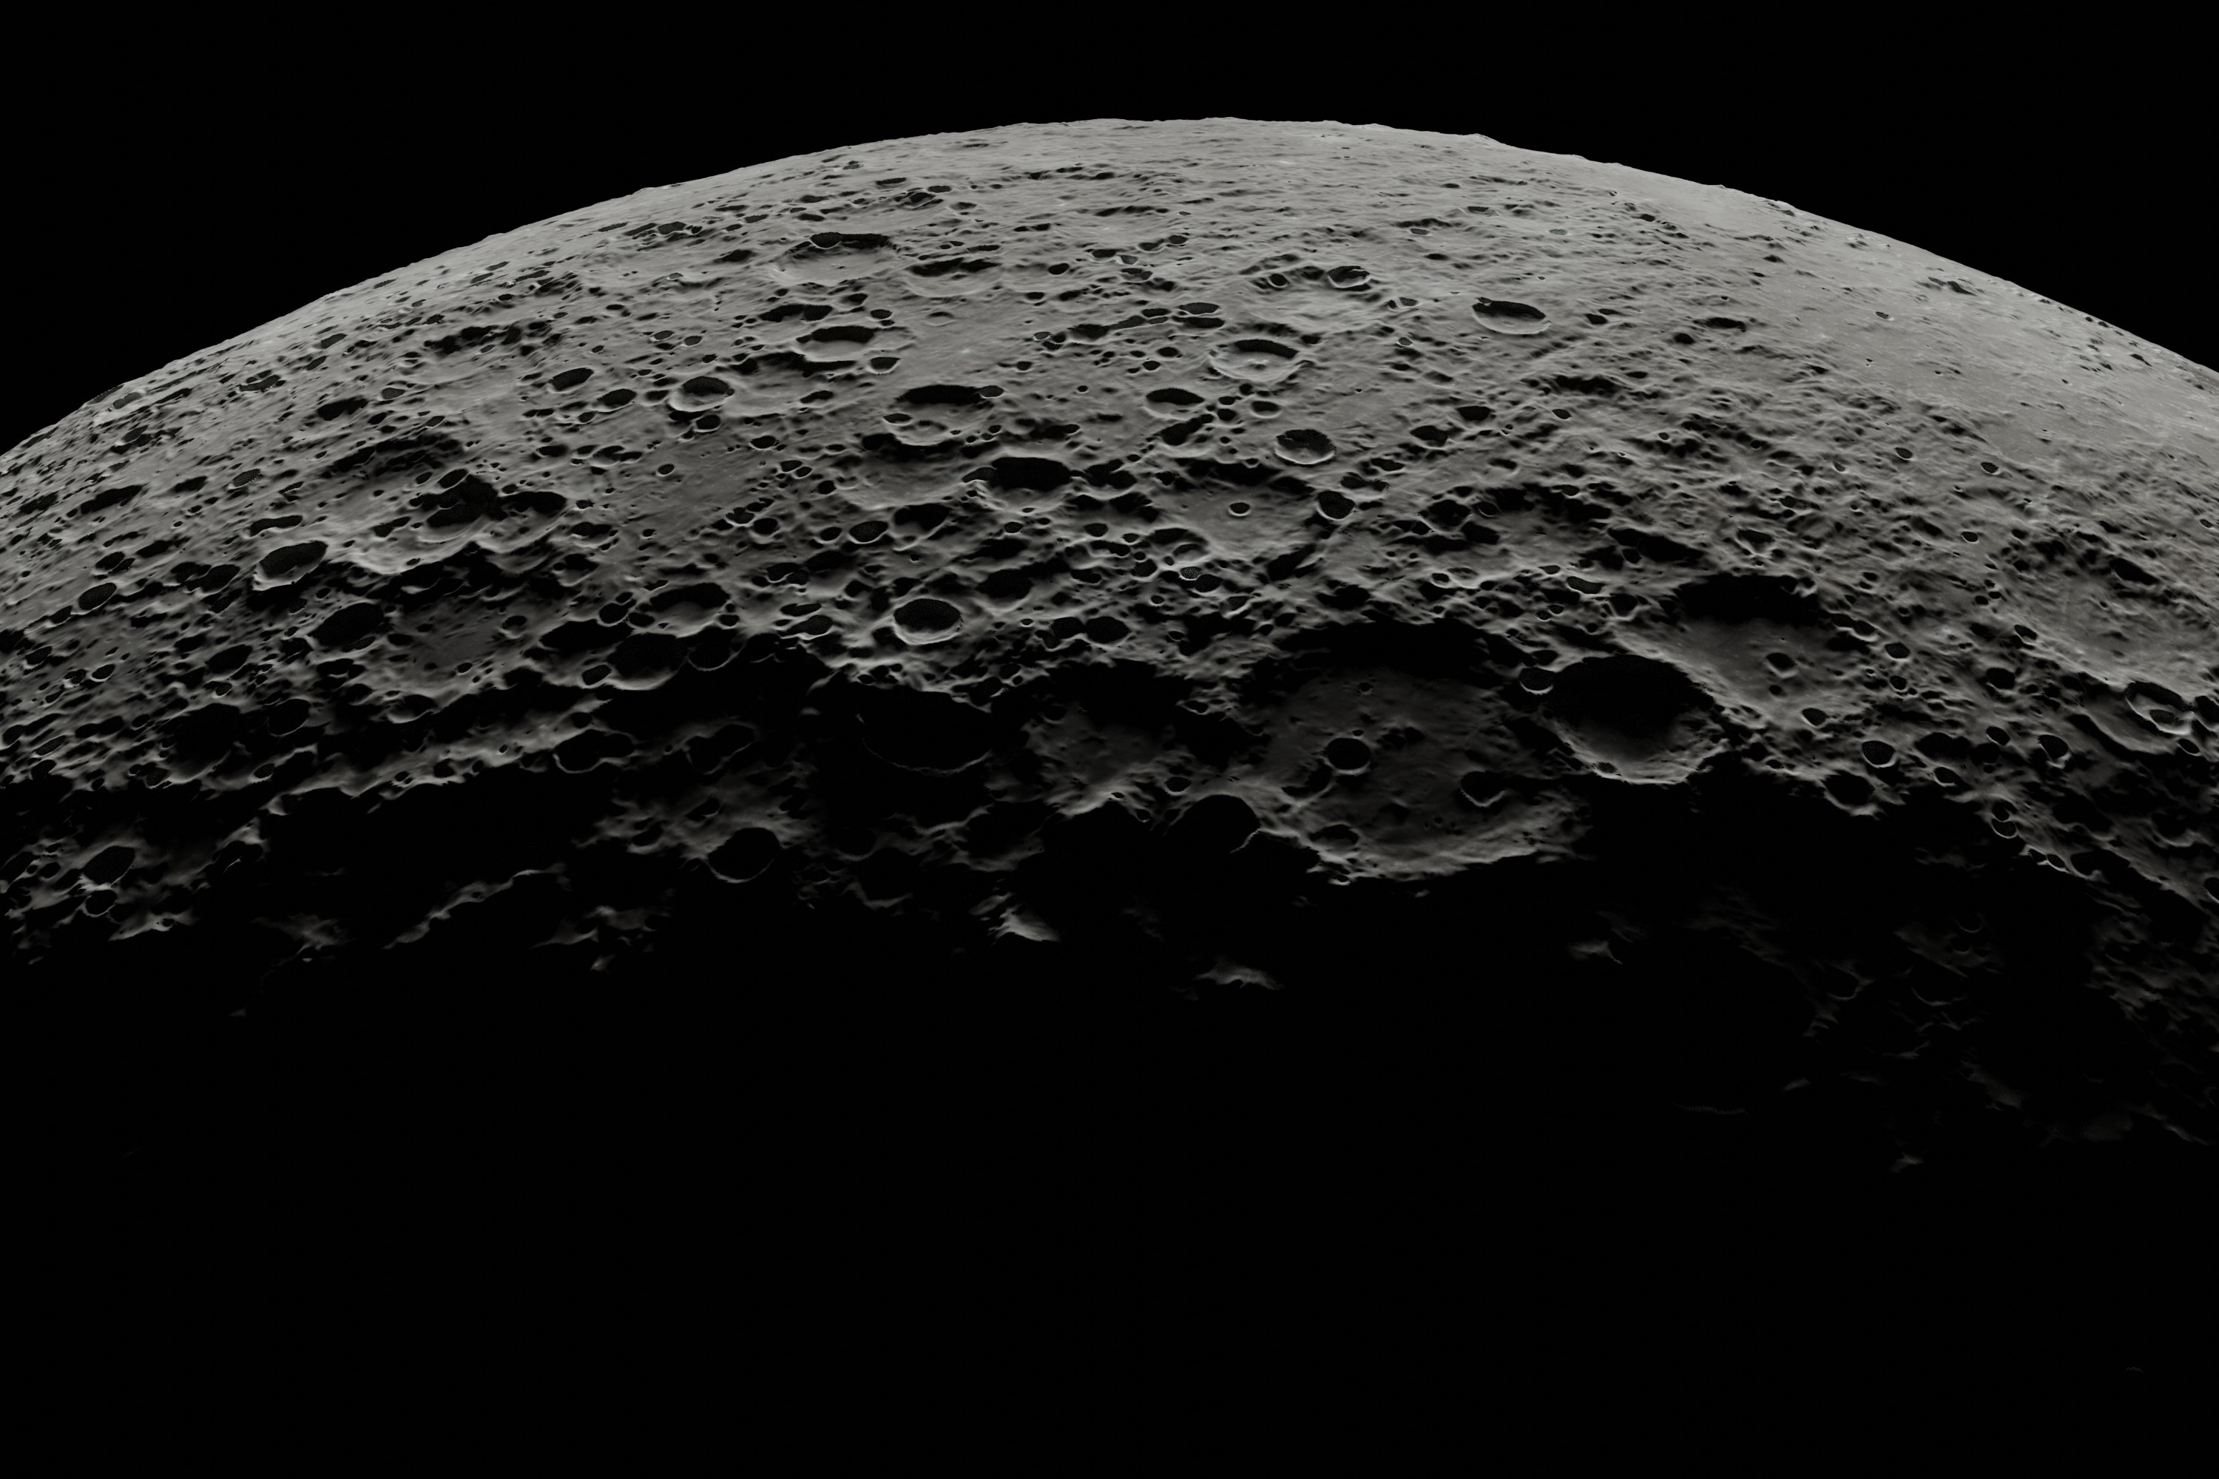

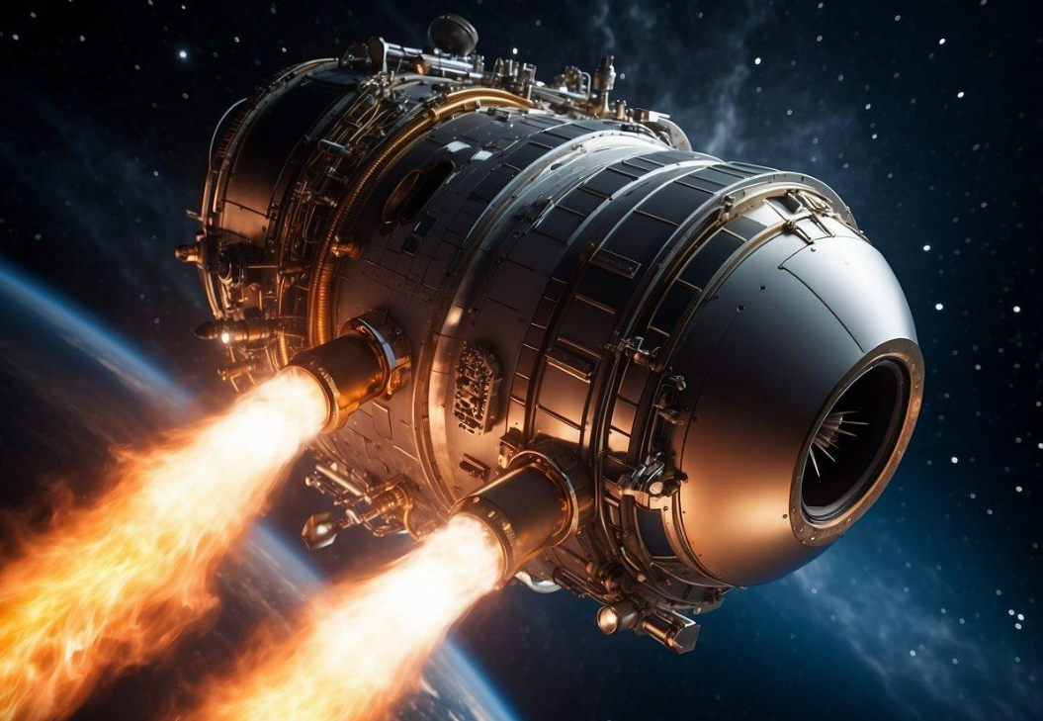
Bonus — “I’ve got a bad feeling about this”
The influx of such amounts of iron and platinum directly in the market might cause it to crash. Therefore, we won’t supply it “ALL” to the market. We plan to keep just enough in the market that the prices decrease by a little and it is profitable to us only.
Once we have monopolized iron and platinum, the world countries could oppose such concentration of resources by us and hence we might get into legal troubles. Therefore we propose to start expansion as soon as we can to get our rovers on the most profitable asteroids, so we have some leverage.

Slide 8


